Slide 1
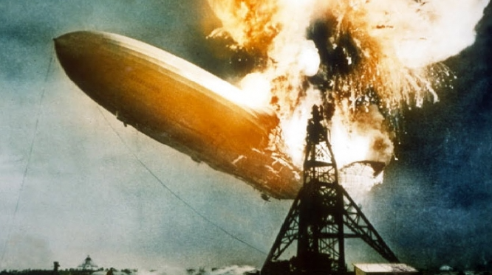
Special Hazards of Hydrogen Gas in the Laboratory
David Frurip, PhD
MSU Consultant
Midland, MI

Slide 2
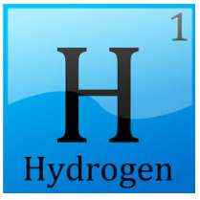
Hydrogen is a Commonly Used Gas in the Chemical Laboratory
Fuel in chromatography flame detectors
Chemistry (reduction reactions, hydrogenations)
Activating catalysts
Semiconductor applications
Maintaining anaerobic atmospheres in glove boxes/bags

Slide 3
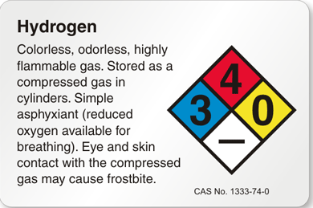
Hazards of Hydrogen in the Laboratory – High Level Summary
Hydrogen is a colorless, odorless, tasteless
Hydrogen possesses the NFPA 704's highest rating of 4 on the flammability scale
Flammable when mixed even in small amounts with ordinary air;
hydrogen gas and normal air can ignite at as low as 4% air due to the oxygen in the air and the simplicity and chemical properties of the reaction.
The storage and use of hydrogen poses unique challenges due to its ease of leaking as a gaseous fuel, low-energy ignition, wide range of combustible fuel-air mixtures, buoyancy, and its ability to embrittle metals that must be accounted for to ensure safe operation.

Slide 4
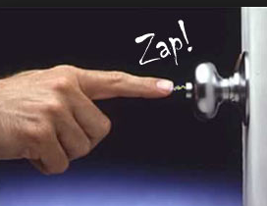
Unique to Hydrogen: Extremely Easy to Ignite
"Hydrogen-air mixtures can ignite with very low energy input, 1/10 that required igniting a gasoline-air mixture. For reference, an invisible spark or a static spark from a person can cause ignition.
"Although the autoignition temperature of hydrogen is higher than those for most hydrocarbons, hydrogen's lower ignition energy makes the ignition of hydrogen–air mixtures more likely. The minimum energy for spark ignition at atmospheric pressure is about 0.02 millijoules.
For reference methane (natural gas) MIE = 0.28 mJ

Slide 5
Unique to Hydrogen: Extraordinarily Wide Range of Flammable Mixtures in Air
The flammability limits based on the volume percent of hydrogen in air at 14.7 psia (1 atm, 101 kPa) are 4.0 and 75.0. The flammability limits based on the volume percent of hydrogen in oxygen at 14.7 psia (1 atm, 101 kPa) are 4.0 and 94.0.
The limits of detonability of hydrogen in air are 18.3 to 59 percent by volume
Detonations are extremely Violent Explosions!!!!
Flames in and around a collection of pipes or structures can create turbulence that causes a deflagration to evolve into a detonation, even in the absence of gross confinement.
For comparison: Deflagration limit of gasoline in air: 1.4–7.6%; of acetylene in air, 2.5% to 82%

Slide 6
Unique to Hydrogen: Exaggerated Hazards from Leaks
Hydrogen is odorless, colorless and tasteless, so most human senses won’t help to detect a leak.
By comparison, natural gas is also odorless, colorless and tasteless, but industry adds a sulfur-containing odorant, called mercaptan, to make it detectable by people.
However, given hydrogen’s tendency to rise quickly, a hydrogen leak indoors would briefly collect on the ceiling and eventually move towards the corners and away from where any nose might detect it.
Hydrogen leaks can support combustion at very low flow rates, as low as 4 micrograms/s.

Slide 7
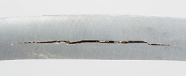
Hydrogen Embrittlement – Leak Hazard!
During hydrogen embrittlement the metal has reduced ductility, toughness, and tensile strength, up to the point where it cracks open!!!
hydrogen embrittles a variety of substances, including
Stainless steel
Aluminum( at high temperatures only), and
Titanium
NOT AN ISSUE WITH: copper (including alloys, e.g. beryllium copper)
BOTTOM LINE: Always use copper tubing and brass fittings in laboratory hydrogen service

Slide 8
Prevention
Ensure hydrogen is never allowed to reach a flammable zone
Minimize the quantities of hydrogen in the lab
Can a lecture bottle suffice vs a size A cylinder?
Minimize electrical equipment near places where a leak might occur
Ensure equipment is properly bonded and grounded as appropriate
Ensure all hydrogen lines are copper with brass fittings.
Where appropriate use hydrogen detectors

Slide 9
Prevention, cont’d
Hydrogen collects under roofs and overhangs, where it forms an explosion hazard
Any building that contains a potential source of hydrogen should have good ventilation
Strong ignition suppression systems for all electric devices,
Preferably be designed to have a roof that can be safely blown away from the rest of the structure in an explosion.
Hydrogen sensors (if appropriate) allow for rapid detection of hydrogen leaks
Ensures that the hydrogen can be vented and the source of the leak tracked down.

Slide 10
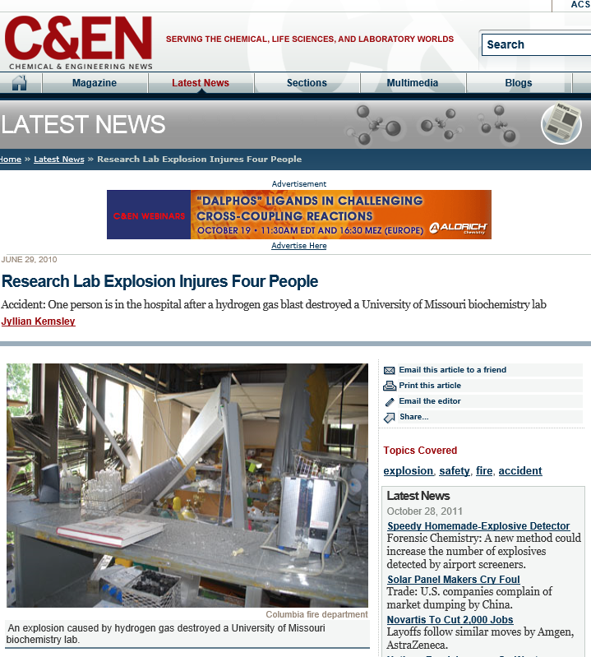
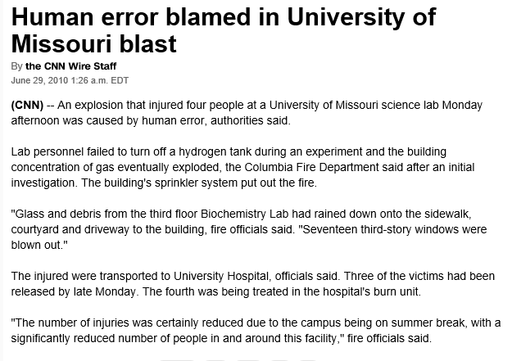
Laboratory Incidents
Univ. of Missouri

Slide 11
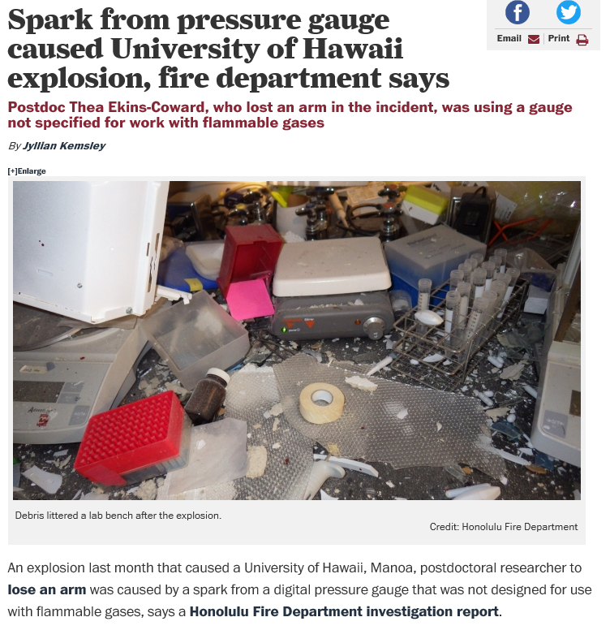
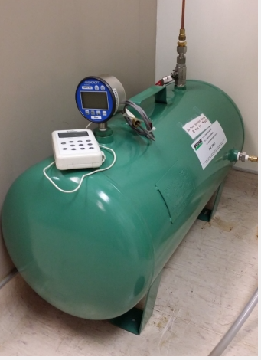
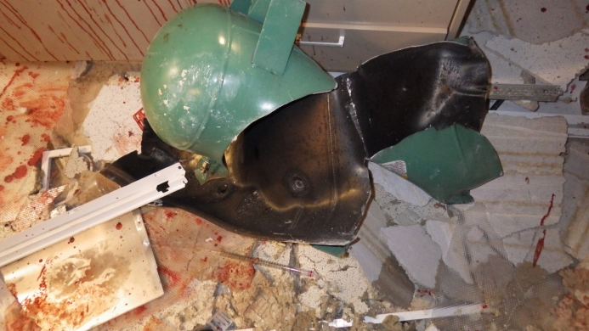
Laboratory Incidents, cont’d
Univ. of Hawaii 2015

Slide 12
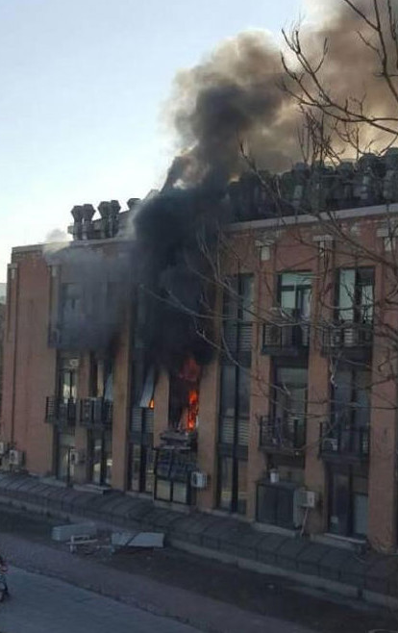
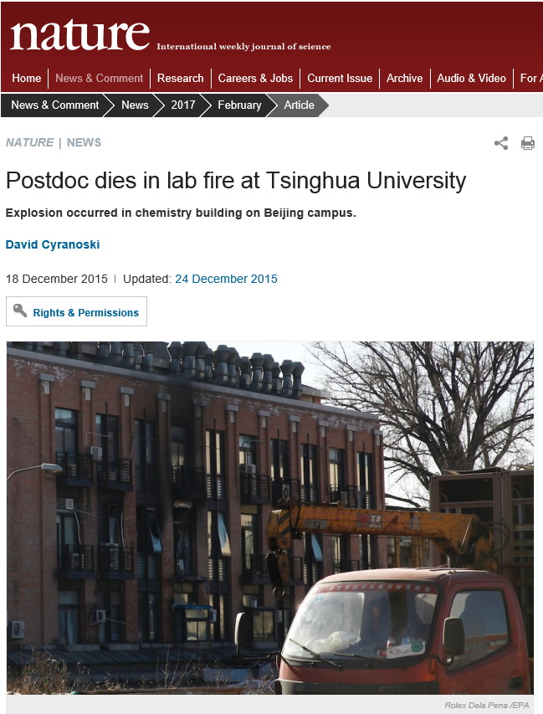
Fatality in China (2015)
“The scientific community in China has been shocked by an accident in a laboratory at the prestigious Tsinghua University in Beijing, where it is believed that an explosion, and resulting fire, from bulk supplied hydrogen gas being used in the lab caused the death of a post doctorate researcher. “

Slide 13
Hydrogen Hazards in This Laboratory and How They are Mitigated
This is a placeholder slide (or slides) for the PI and staff to indicate:
How hydrogen is used in their lab?
What credible scenarios could occur where flammable hydrogen atmospheres might occur?
Include normal operation and worst case scenarios
What measures are in place to mitigate/prevent the situations in bullet 2.
Include engineering controls and operating discipline

Slide 14
Conclusions
Hydrogen is a special flammable gas with unique hazardous properties
Extra attention and safety evaluation are required using hydrogen in the laboratory
Minimize the quantities used in the lab as is practical
Always use copper tubing in hydrogen service
Involve EHS and other experts to ensure your process does not operate in a flammable zone

